Slide 1
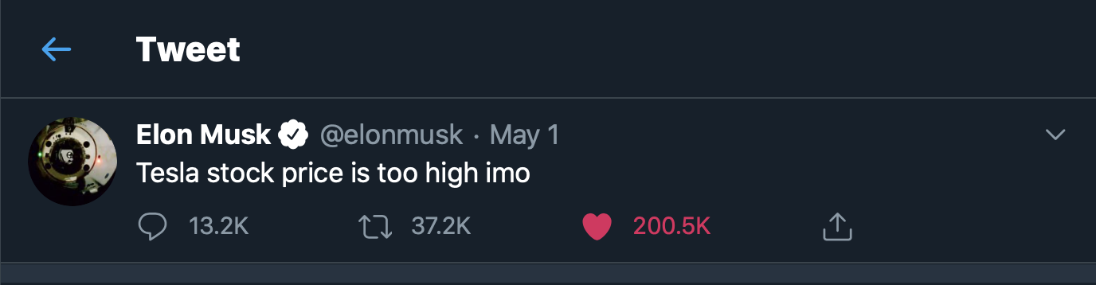

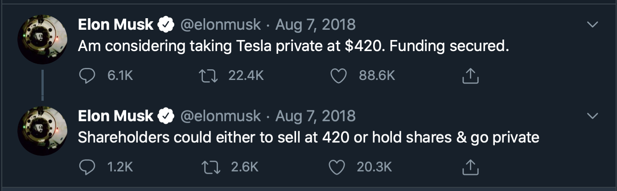

Elon Musk Twitter Analysis Time Series Tesla Price Prediction
By: Justin Huang

Slide 2
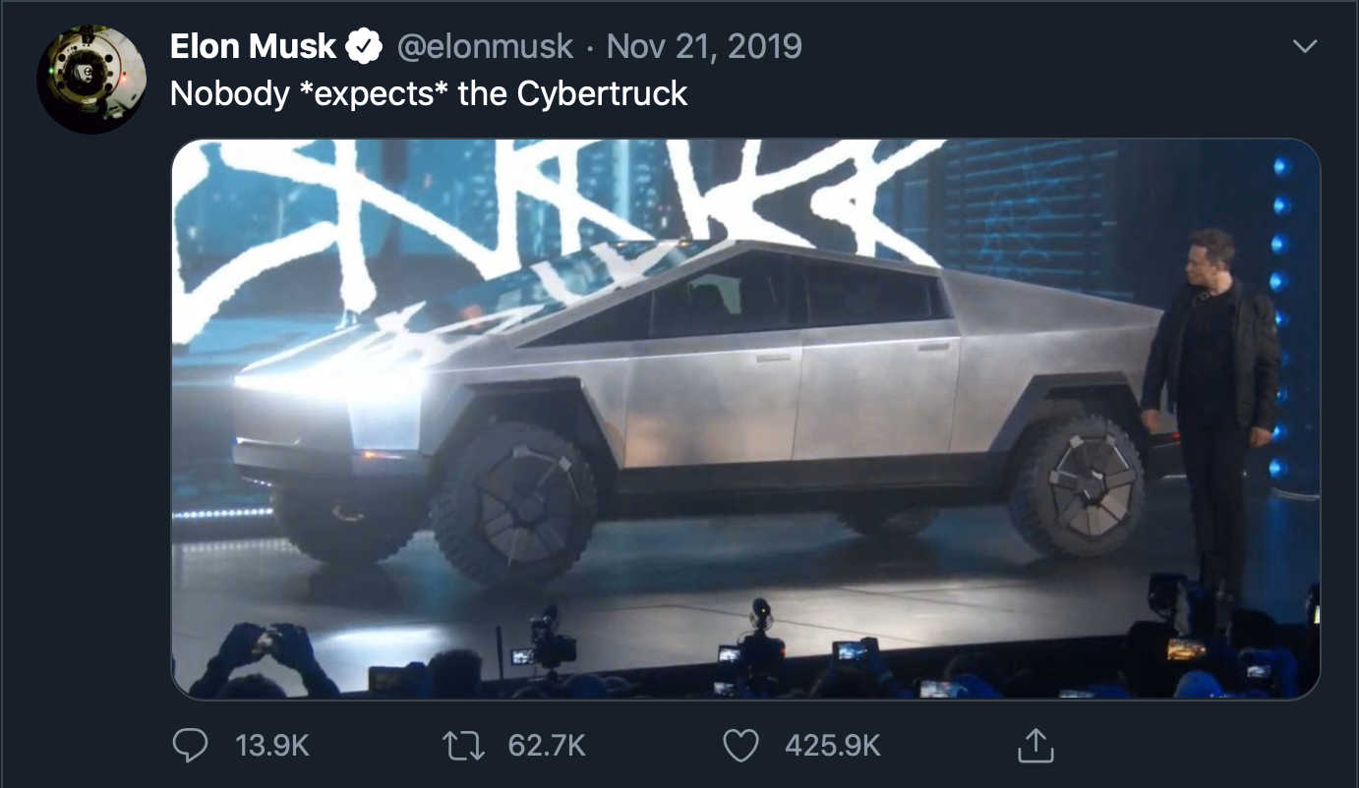
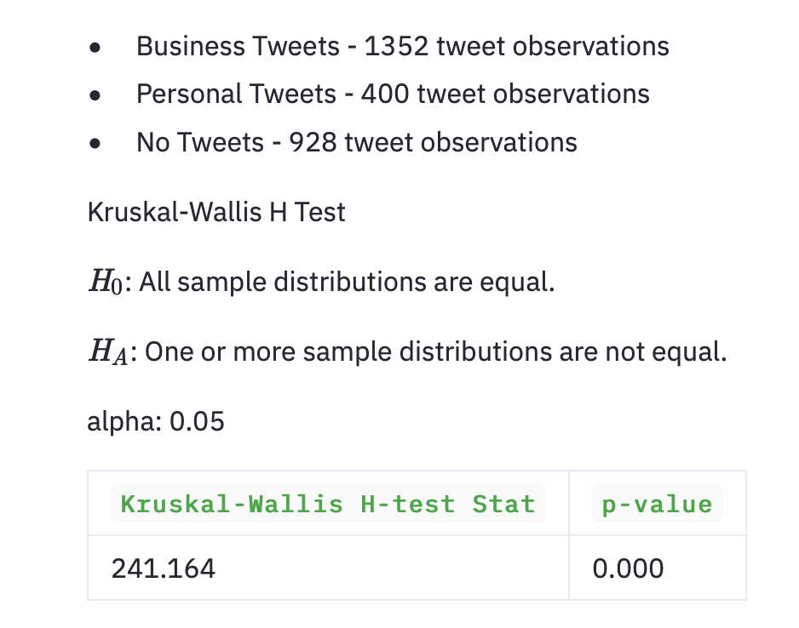
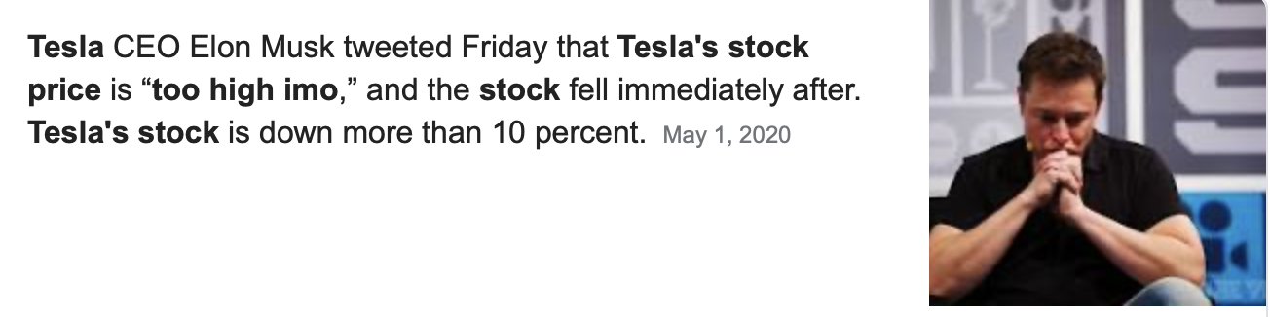
Elon’s Tweets
Hypothesis

Slide 3



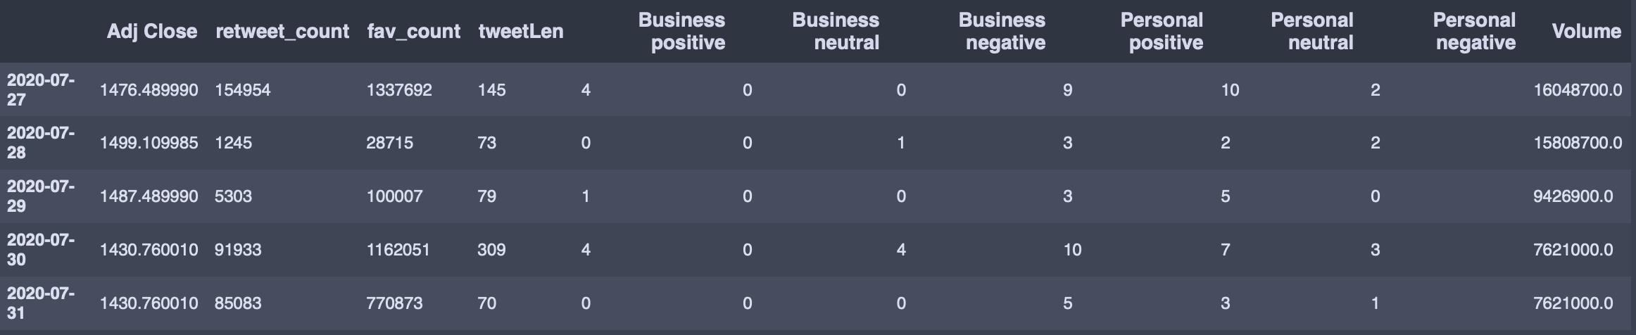
Data Wrangling and Cleaning
GetOldTweets3
Collected Old Tweets from Elon’s first Tweet Jun 4th , 2010 till July 31, 2020.
Pandas datareader
Financial Data collected through yahoo finance API
Text Wrangling
Used Regex for Key Business Words then reviewed over manually
Then Applied Sentiment labeling with NLTK vader.
Numeric Wrangling
Loaded in Financial data from June 29th , 2010 to July 31, 2020.
Combining Text with Numeric
Combined on Date and decided to go from 2011-12-1 to 2020-7-31 since before that time Elon didn’t tweet.

Slide 4
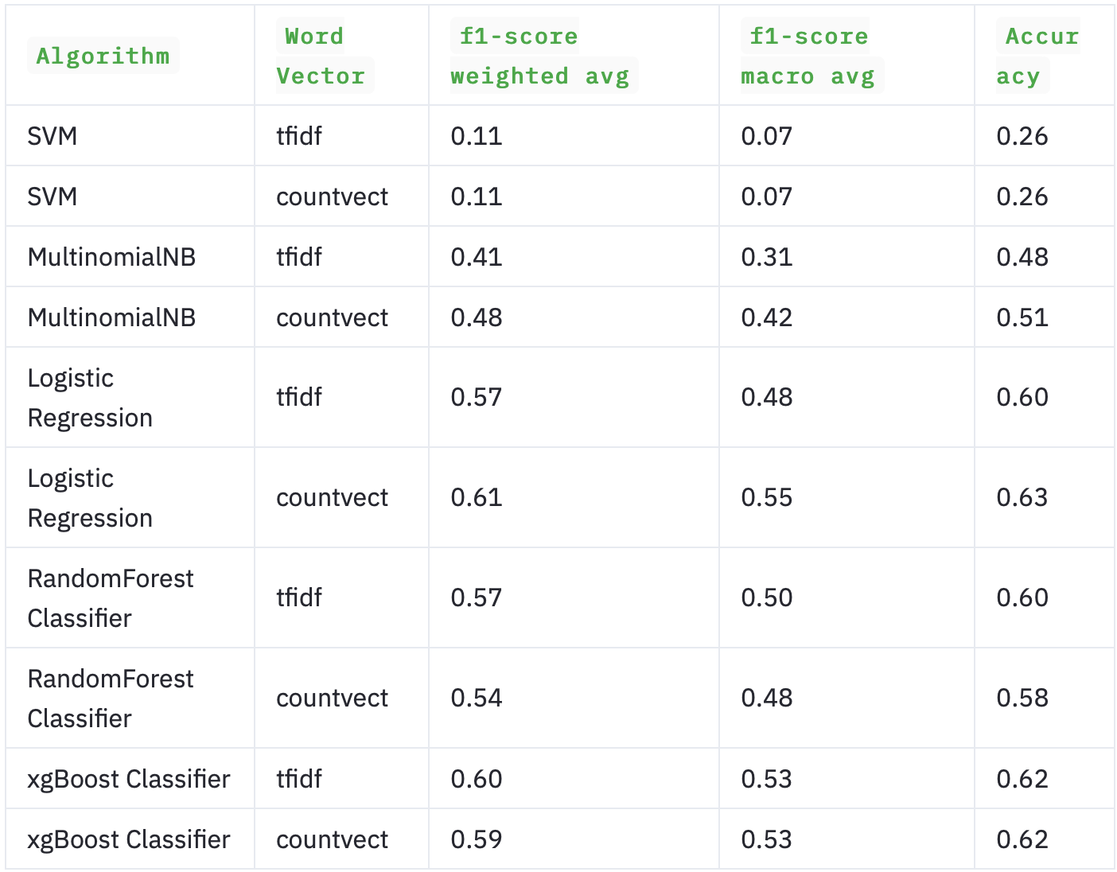
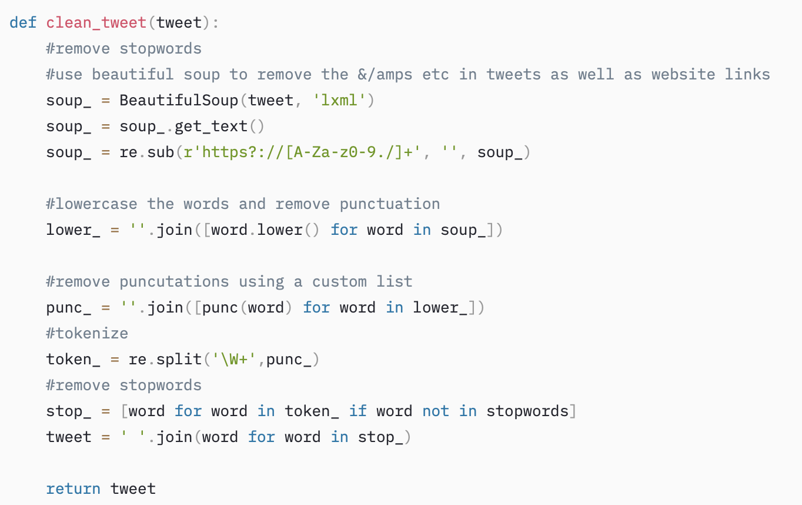
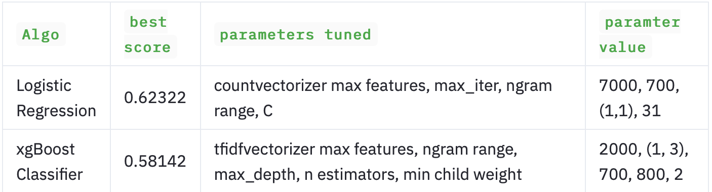
Classical Classification
Classical Methods
Text Preprocessing
Hyperparameter Tuning

Slide 5
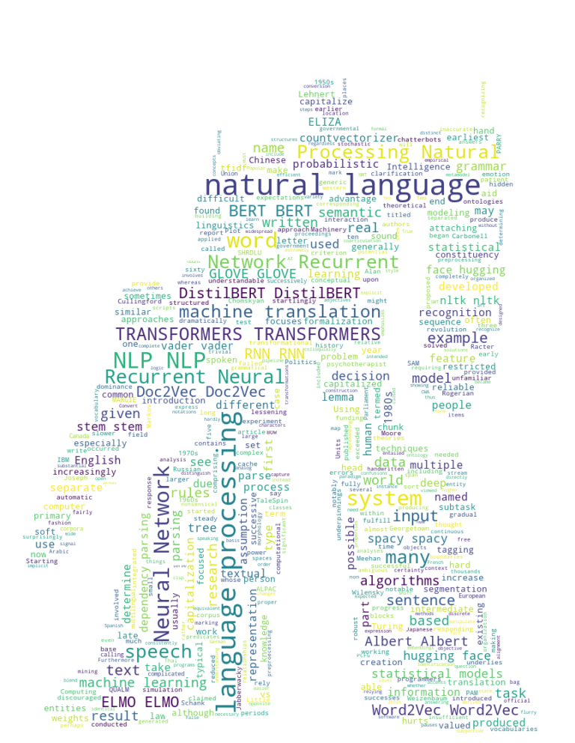


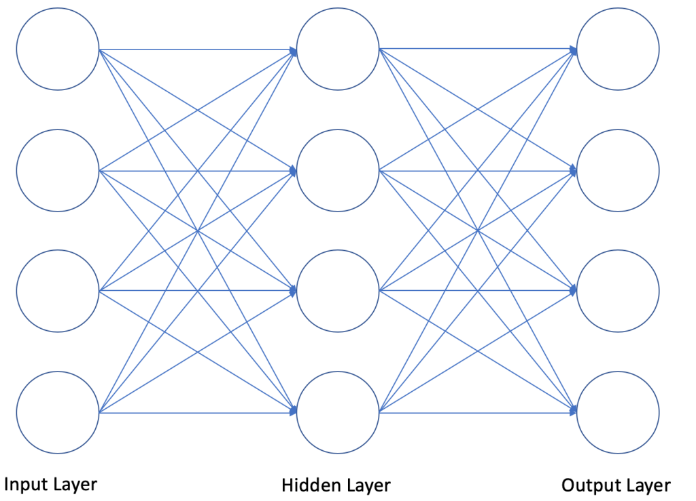
Bidirectional encoder representations from transformers
0 %
Business Positive
Tweets
Bert Base
Classifier
15%
Business Neutral
Feed Forward Neural Network + Softmax
Encoder
85%
Business Negative
12
…
0 %
Personal Positive
Encoder
3
0 %
Personal Neutral
Encoder
2
0 %
Personal Negative
Encoder
1

Slide 6
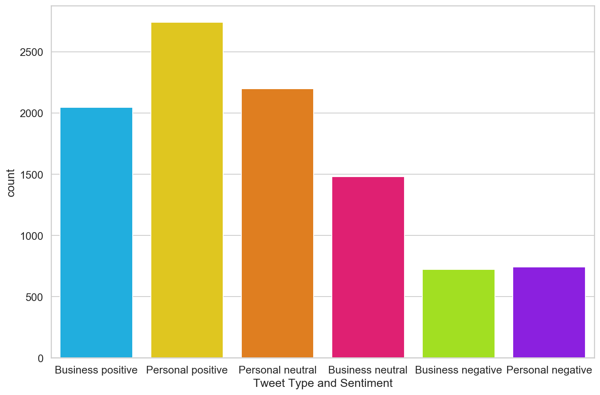
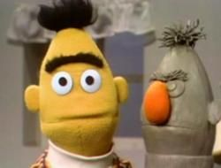
BERT and DistilBERT
DistilBERT! BERT with 44 million less parameters who needs a nose! 2 GB model vs 280 mb model
Transformers compared to LSTMs feed in the words at once rather than sequentially
better at handling long-term dependency of words.
BERT is able to understand text left to right, as the importance of the text might be right after a few words of text.

Slide 7

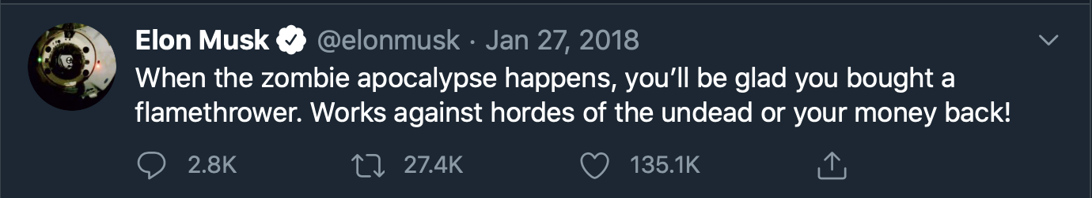
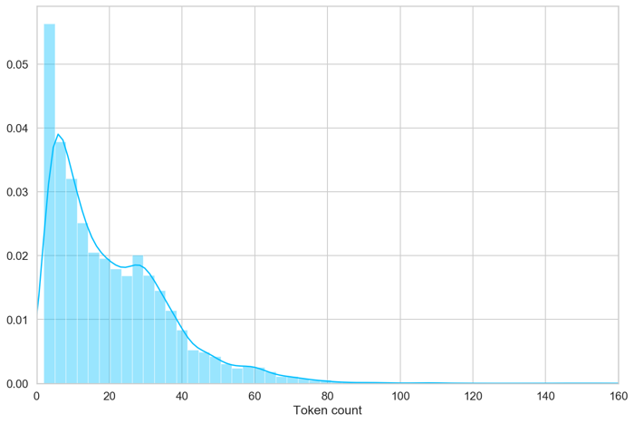

DistilBERT
Bert will convert the text to tokens.
Special Tokens:
CLS – BERT knows it’s a classification
SEP – marker end of sentence
PAD – Token for padding
UNK – Understands token in training set everything else will marked as UNK
['[CLS]', ‘When', ‘the', ‘zombie', ‘apocalypse', ‘happens', ‘you’, ‘’’ ‘ll’ ‘be’ ’glad’ ‘you’ ’bought’ ’a’ ‘flamethrower’ ‘.’ ‘[SEP]’ ‘Works’ ‘against’ ‘hordes’ ‘of’ ’the’ ‘undead’ ‘or’ ’your’ ‘money’ ‘back’ ‘!’ ’[SEP]’, ‘[PAD]’]
Trained with 80 tokens
Batch size was 16
Transfer Learning 10 epochs
drop out at 0.3
Adam Optimizer lr 2e-5

Slide 8
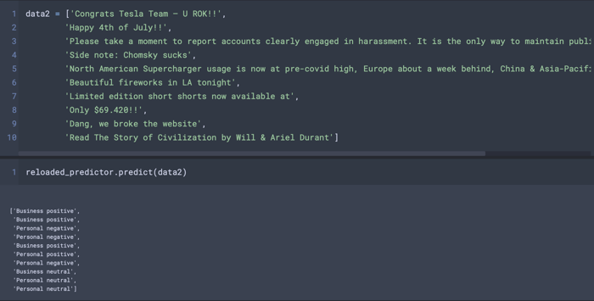
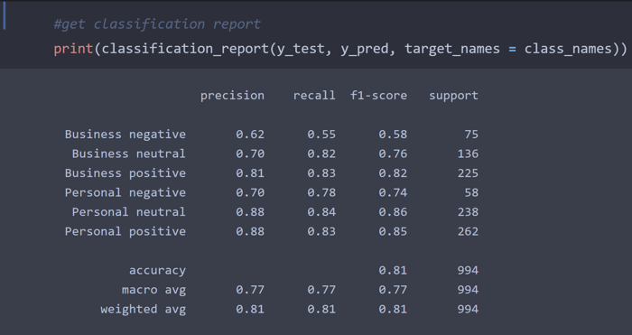
DistilBERT
Testing Class Predictions
Classification Report

Slide 9
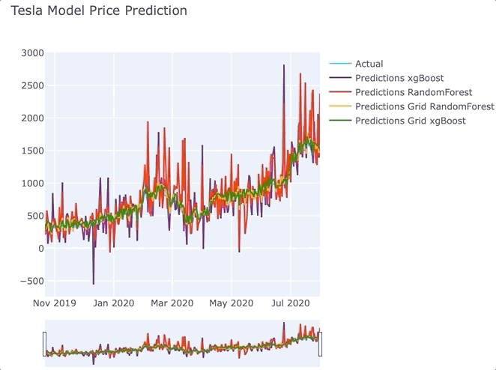
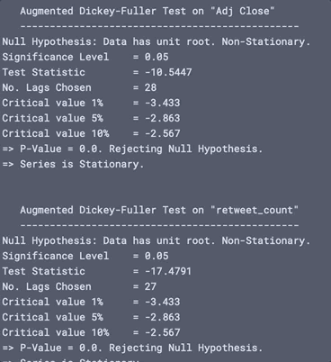
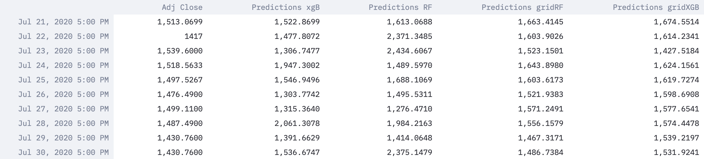
Time Series Prep and Classical Models
Dickey Fuller Test
RF and XGBoost
First, we used the Dickey Fuller Test to test if the data was stationary.
first difference
Scaled the data using MinMaxScaler (-1 to 1)

Slide 10
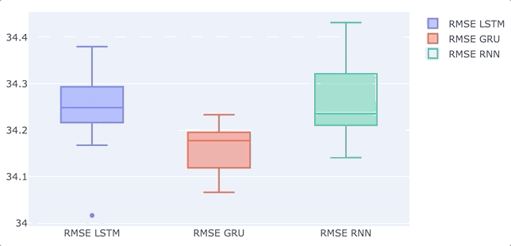
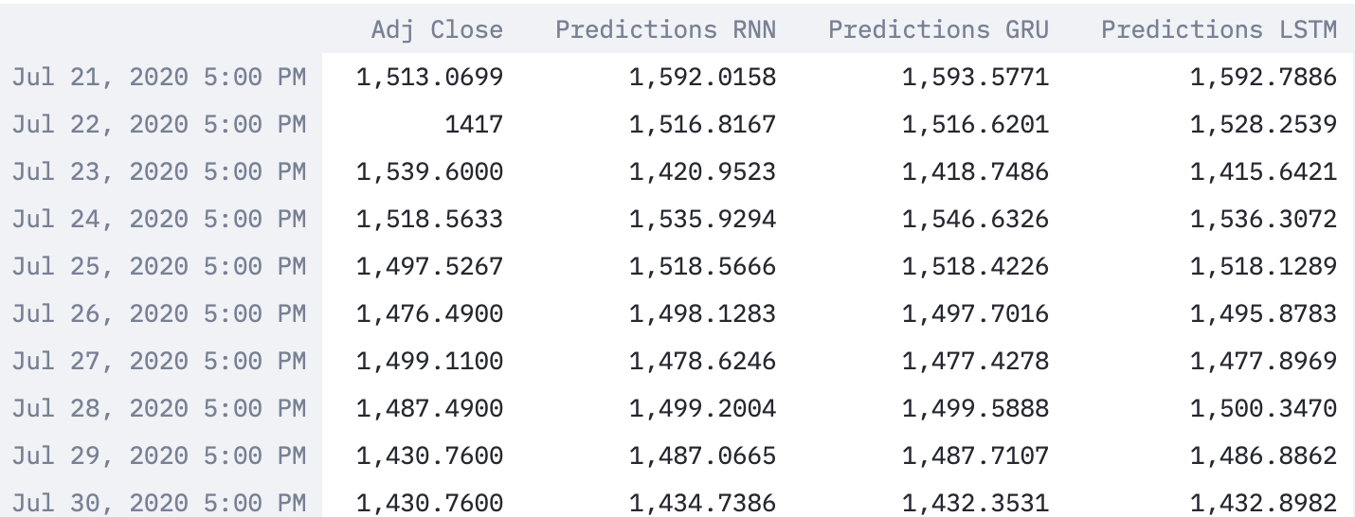
LSTM GRU Vanilla RNN
RNN is good for sequence data
Text, audio, time series
A sequence can be like the Alphabet
Problem with RNN it suffers from the vanishing gradient problem and forgets earlier time steps
Vanishing gradient happens in backpropagation when the network learns from the loss function.
To solve this short-term memory LSTM and GRU was developed to include ”gates”
These gates control the flow of information so earlier steps can flow to the very end.

Slide 11
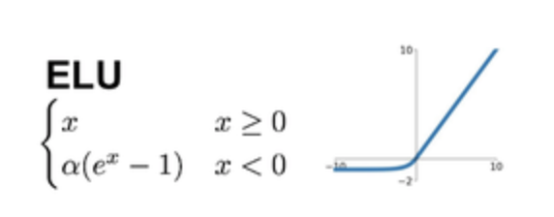
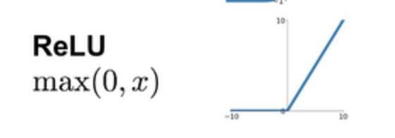
Gated Recurrent Units
out
Reset Gate- decides how much past information to forget.
Update Gate-Decides what information to get rid of and add.
Changed the recurrent activation to ReLU vs Sigmoid
Changed the activation to ELU vs tanh
Adam optimizer learning rate 0.0001
Batch Size 8
Neurons 500
Loss – mean squared error
Dropout – 0.3
h_{t-1}
x
h_{t}
+
Reset Gate
1 -
x
x
Update Gate
in
Notes:
At this gate, the network learns how much past information to push forward, here the input (x_{t}) along with its weight (w_{t}) are multiplied together which are further added with the multiplication of previous hidden state (h_{t-1}) along with its weight (w_{h}). Further, this value is processed under the sigmoid function to compress the value in the range of 0 to 1. Hence the update gate helps in curing vanishing gradient issues.
u_{t} = sigmoid [ (x_{t}) * (w_{t}) + (h_{t-1}) * (w_{h}) ]
2. Reset Gate
Reset gate is almost the same as the Forget gate of LSTM, as it sorts the irrelevant data and tells the model to forget this data and move forward without it. However, the formula is almost the same as the update gate and only differs at weights and functionality.
r_{t} = sigmoid [ (x_{t}) * (w_{r}) + (h_{t-1}) * (w_{hr}) ]
If we observe closely, it functions the exact opposite of what the Update Gate does. Here, the Sigmoid Function converts the value in the range that lies between 0 to 1 and the value closer to zero will not be used further while the value ranging closer to 1 will be processed forward.
3. Current Memory Content
Let's consider an example of a movie review “Chhichhore’ has a relevant message on the inherent attitude towards academic success and failure that will connect with many youngsters and parents of today. It tells you that the journey is far more important than the destination and that losing is as critical a life lesson as winning. The film scores high on many accounts and is certainly worth watching.”
As we can see the last line depicts the result or conclusion of the review, so our neural network will learn with the help of the reset gate to ignore all other information written above, current memory content uses reset gate for the functioning like sentiment analysis. Let’s see it’s equation:-
cm_{t} = tanh (wx_{t} + r_{t} x yh_{t-1})
Here, x_{t} is multiplied with its weight w and added to the Hadamard product of previously hidden state multiple of its weight. Here, the Tanh function is used to make the values to fit in the range that lies between -1 to 1.
4. Final Memory at Current time state
Let's suppose that while doing sentiment analysis of a movie review, we found the best information at the very first line itself and all other information in the text is of no use, then our model must be able to sort the sentiment out from the first line and ignore other text. It basically carries the current state input which needs the Update gate, hence the Update gate is an essential prerequisite for this final stage. Let's see its equation:-
f_{t} = u_{t} x (h_{t-1}) + (1-u_{t}) h'_{t}
Here, ‘X’ shows the Hadamard product of the Update gate and current information which is added to the Hadamard product of (1-u_{t}) and h'_{t} where h'_{t} show the information or content that is needed to be collected from current information unit.

Slide 12
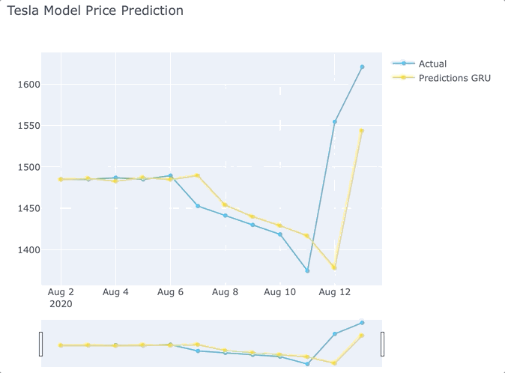
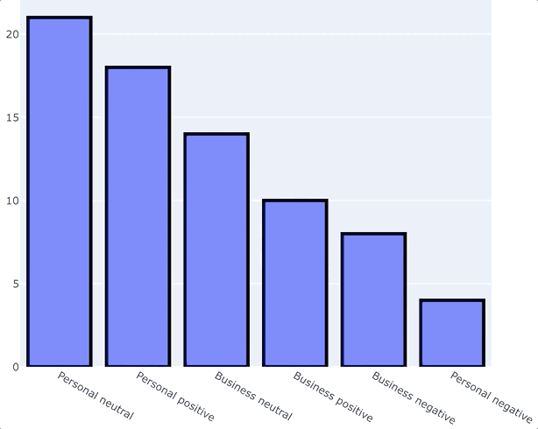
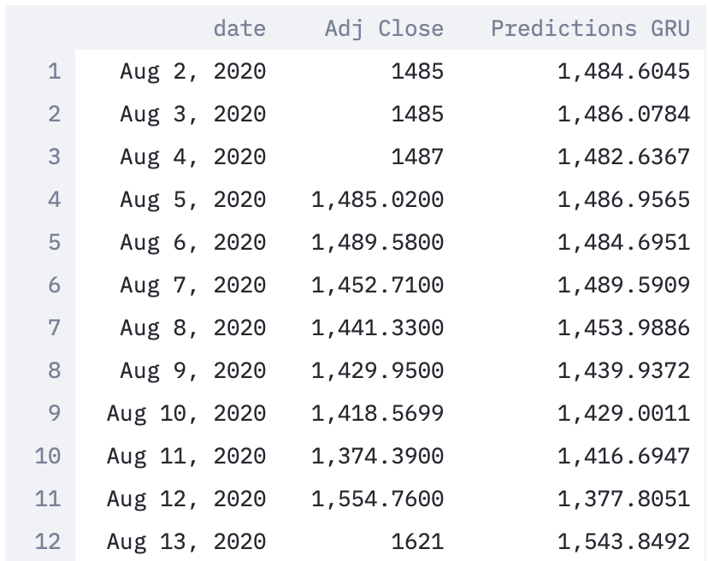
Gated Recurrent Units
GRU Price Prediction
Classification using DistilBERT
Train in on out of sample data first use DistilBERT to classify the tweets
Then import our trained scaler and GRU model to make a prediction
Looks like it didn’t predict the stock split news, but Elon also didn’t tweet about it!

Slide 13


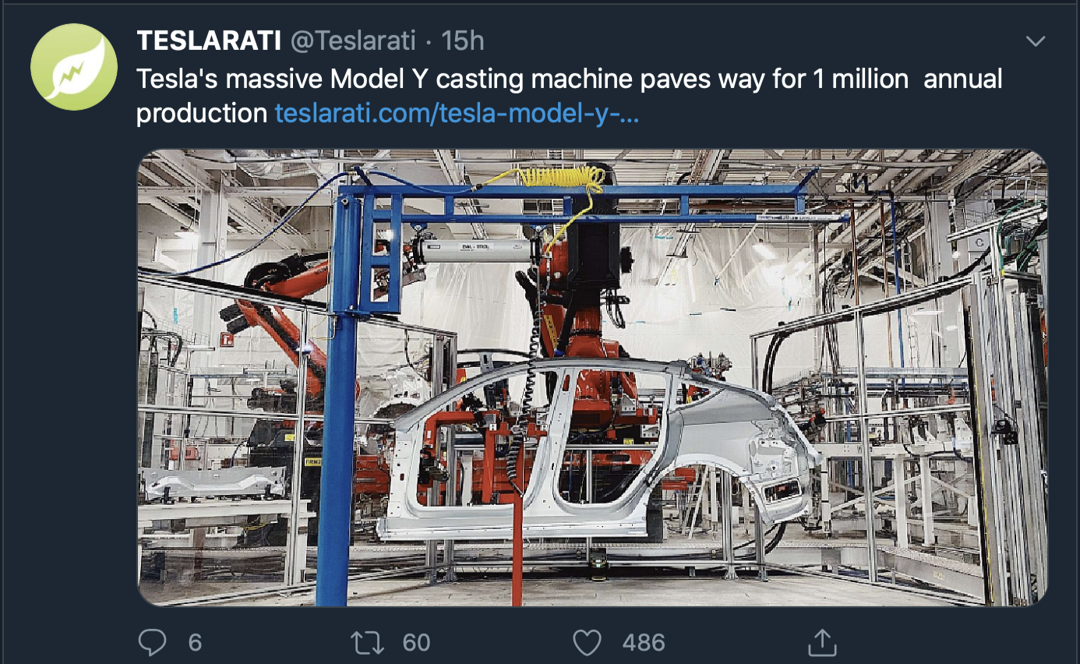
Future Work to think about
Include SEC Edgar 8k information
Include a business side tweeter
Instead of classifying as business and personal classify as 3 types of losses and gains

